Slide 1
NuBot 2014 new Platform
RoboCup MSL Workshop
2014.11.10, Eindhoven

Slide 2
Outline
New mechanical design
The vision system
The electrical system
ROS-based softwares

Slide 3
Outline
New mechanical design
The vision system
The electrical system
ROS-based softwares

Slide 4
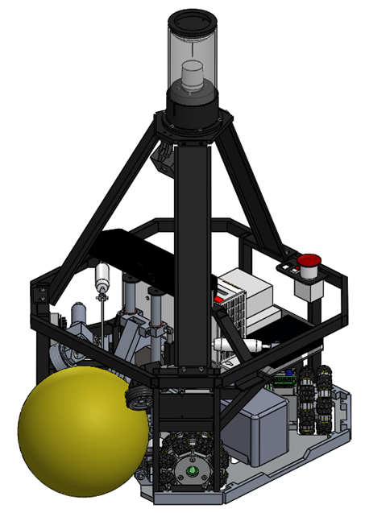
New mechanical design
Goals:
Light weight;
Robust to collisions;
Easy to maintain;
Maximum capabilities;

Slide 5
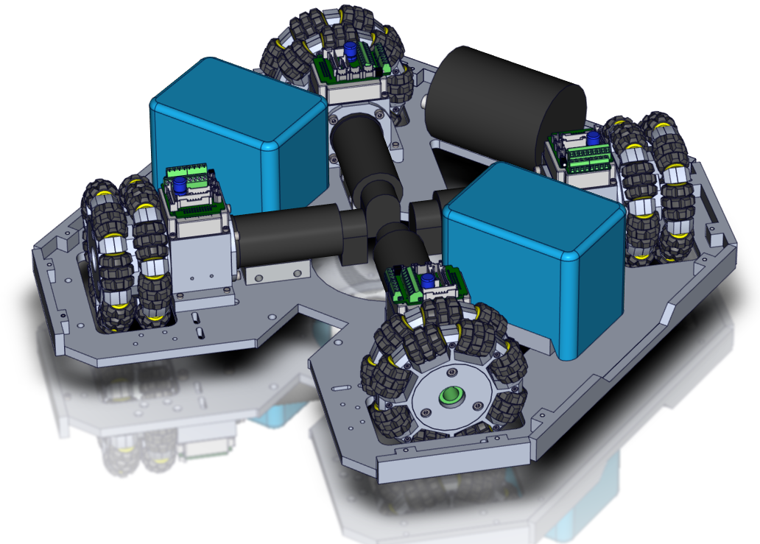
Base plate
Capacitor
Wheel Module
Battery

Slide 6
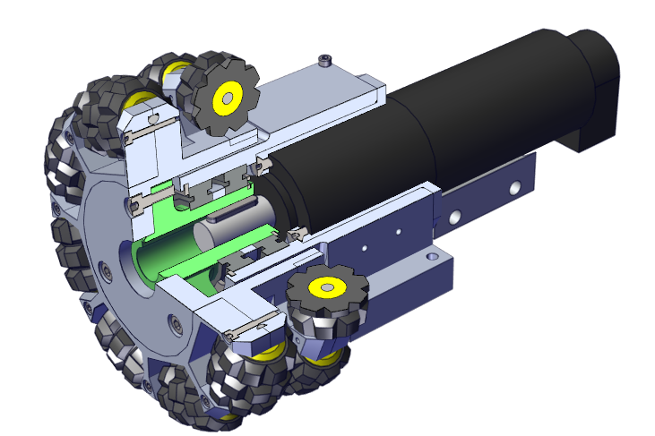
Wheel Module
Features:
Direct transmission;
Compact;
Easy maintain.

Slide 7
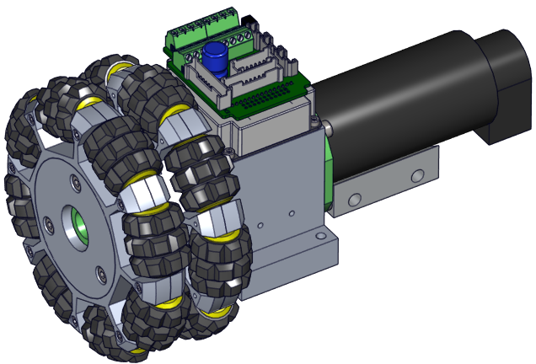
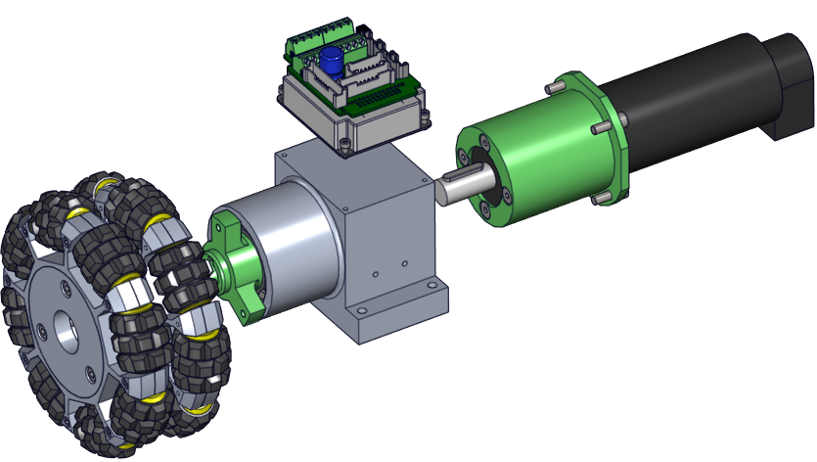
Wheel Module
Easy to assembly & disassembly
Motor Driver

Slide 8
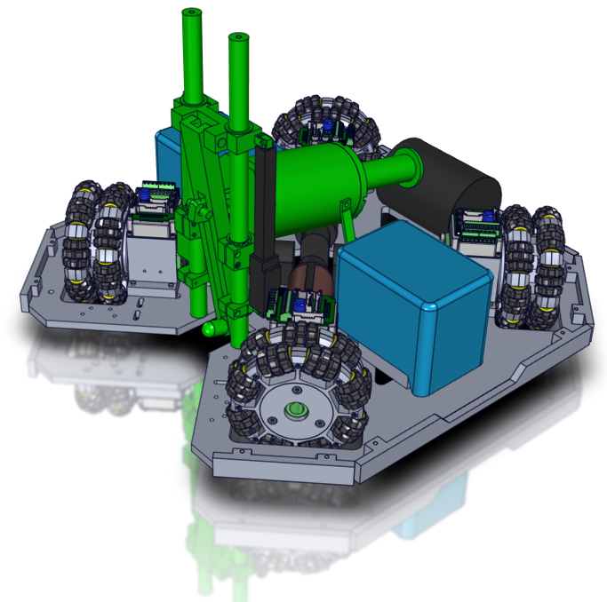
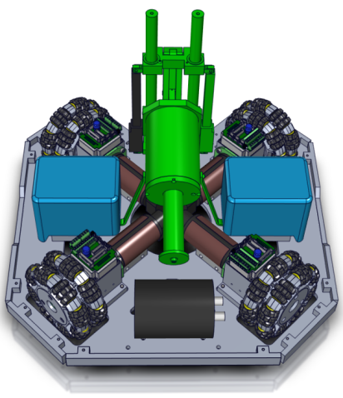
Kicking Device

Slide 9
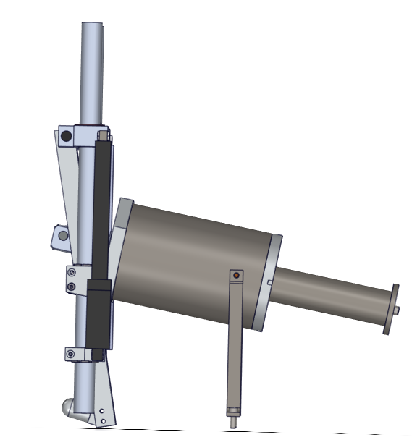
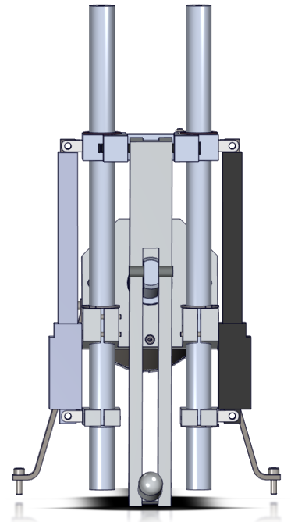
Kicking Device
Linear Actuator with potentiometer
Solenoid

Slide 10
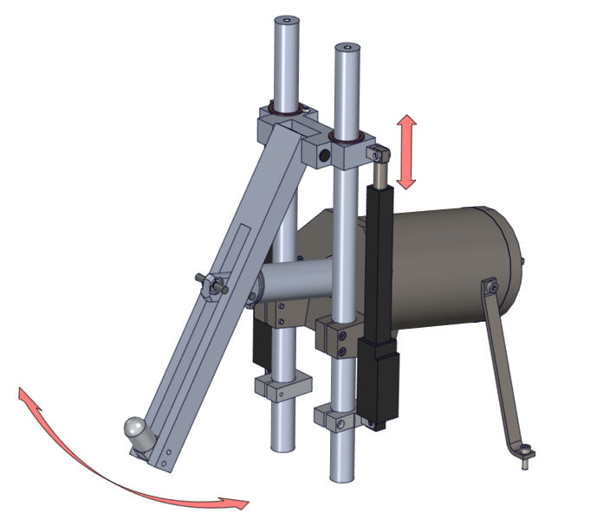
Shooting Device
Features:
Simplicity;
Continuous height adjustment;
Various shooting configurations.

Slide 11
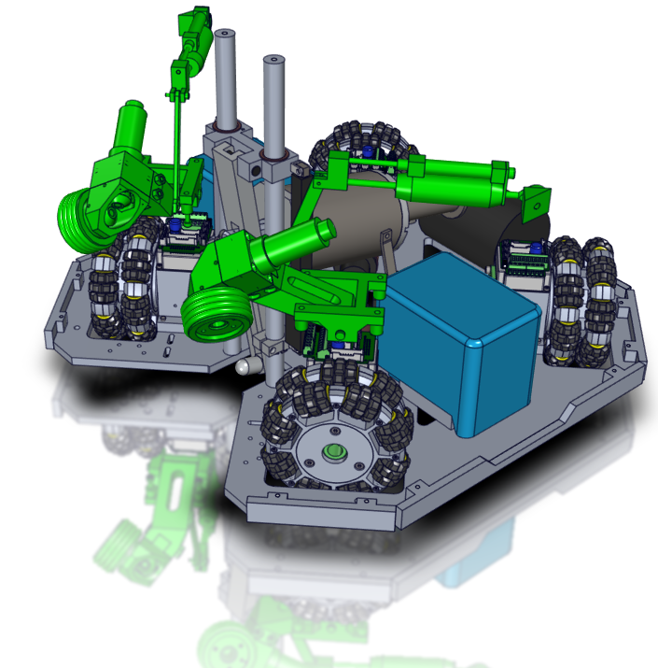
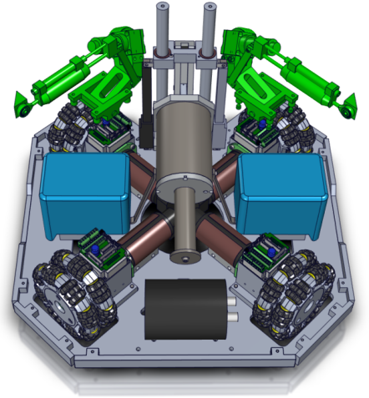
Ball Handling Device

Slide 12
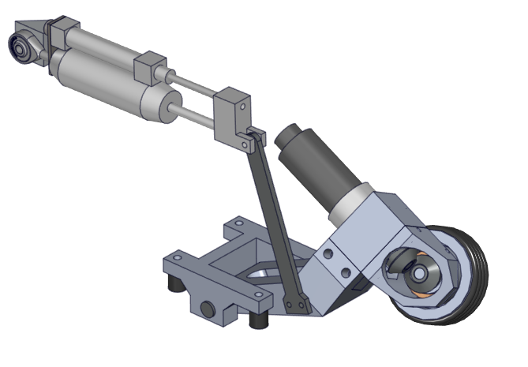
Ball Handling Device
Damper
Motor
Potentiometer
Rubber

Slide 13
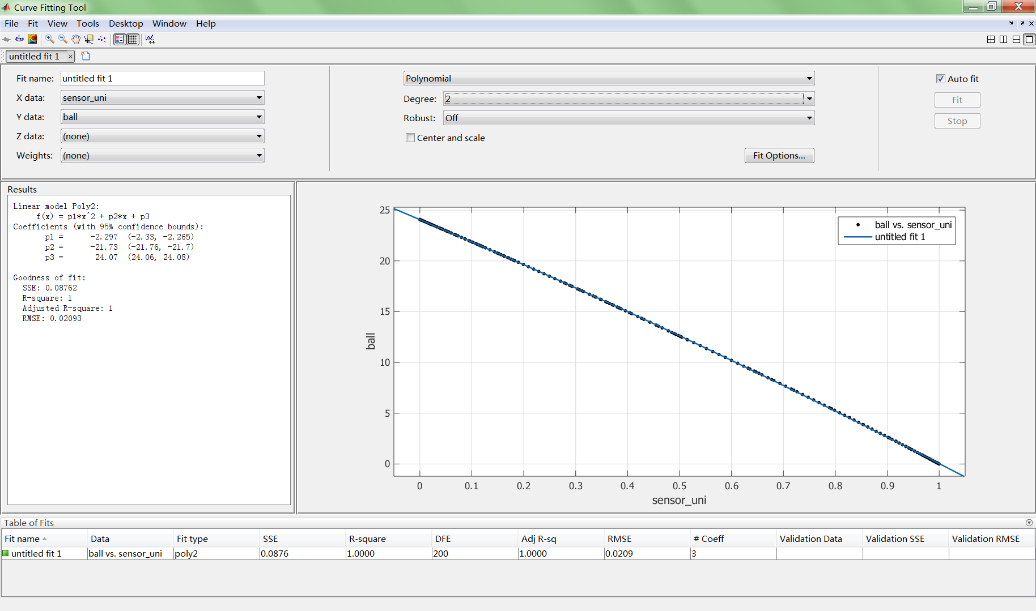
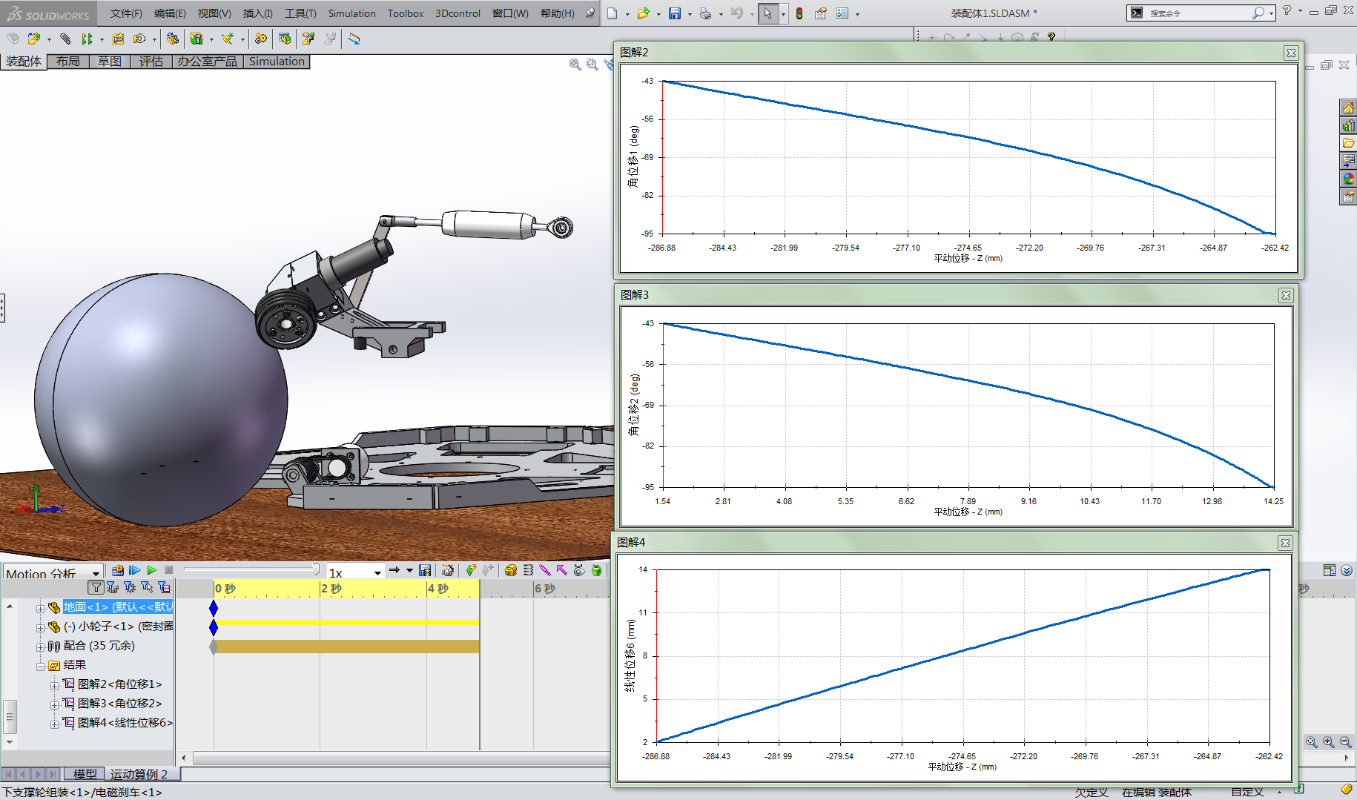
Ball Distance & Sensor Readings
Good Linearity

Slide 14
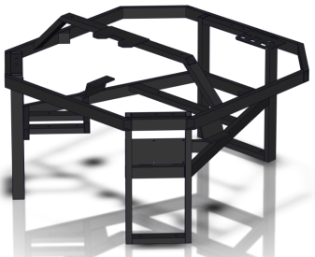
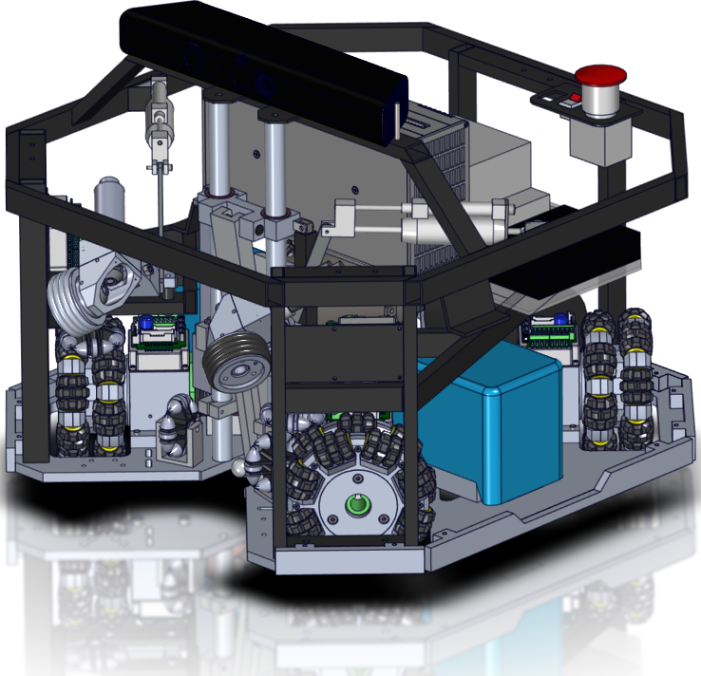
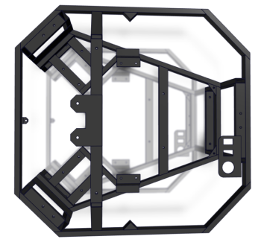
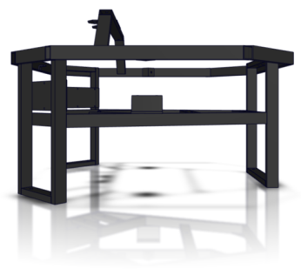
Welded Main Frame

Slide 15
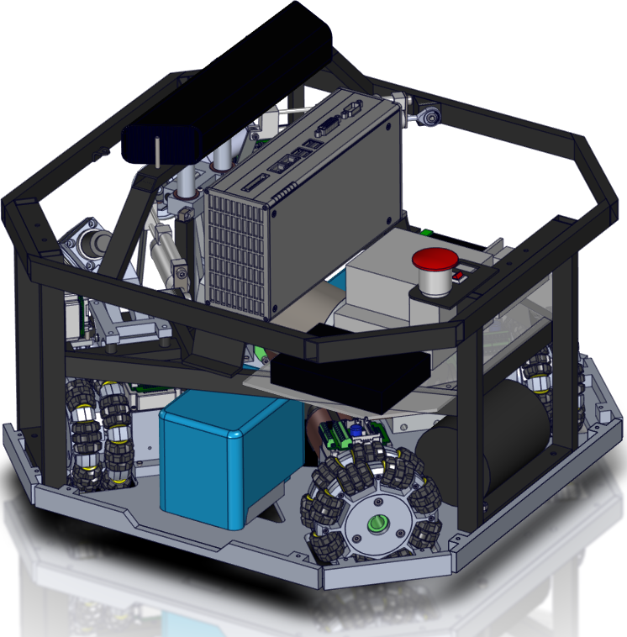
Welded Main Frame
Beckoff PC
EtherCat Module
Features:
Light weights;
Easy separation between base plate and upper body;
Kicker Control

Slide 16
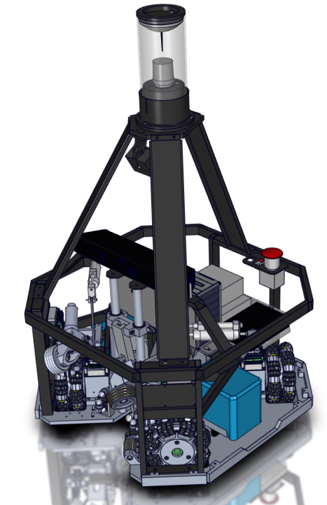
Vision Systems
Omni-vision
Front camera
RGB-D camera

Slide 17
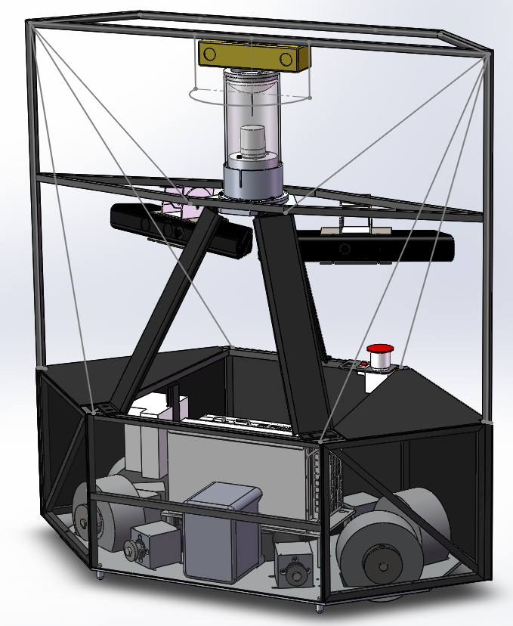
Goalie
Bumblebee Stereo-vision
Kinect x2
Features:
Light weight;
Acceleration enhanced;
3D sensing enhanced.

Slide 18
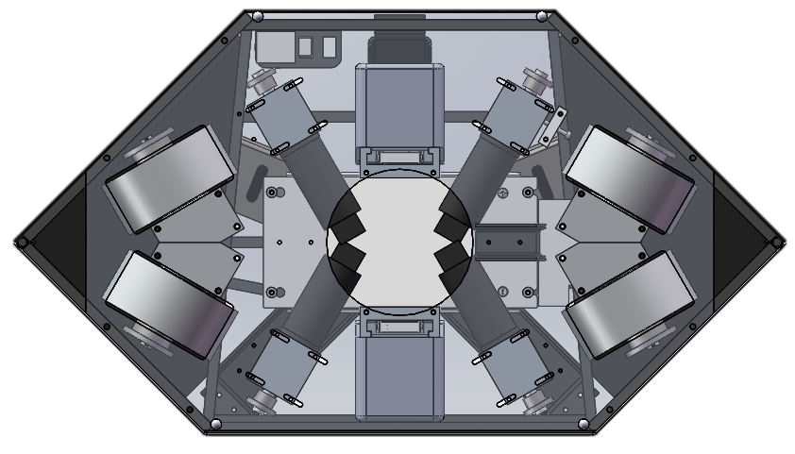
Goalie
Inspired by TU/e

Slide 19
Outline
New mechanical design
The vision system
The electrical system
ROS-based softwares

Slide 20
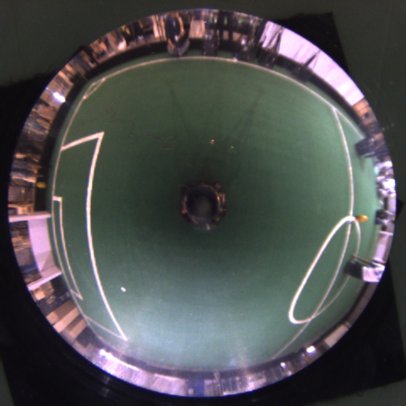
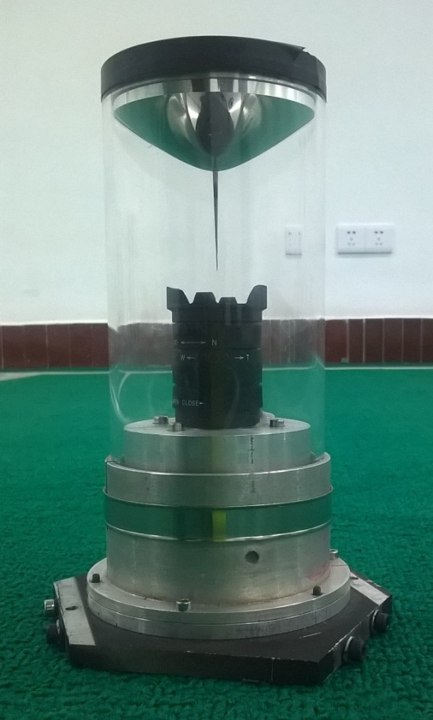
Omnidirectional vision for NuBot
The mirror was developed by TU/e

Slide 21
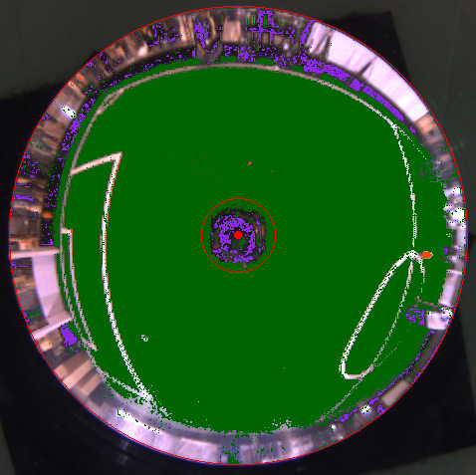
Omnidirectional vision for NuBot

Slide 22
Omnidirectional vision for NuBot

Slide 23
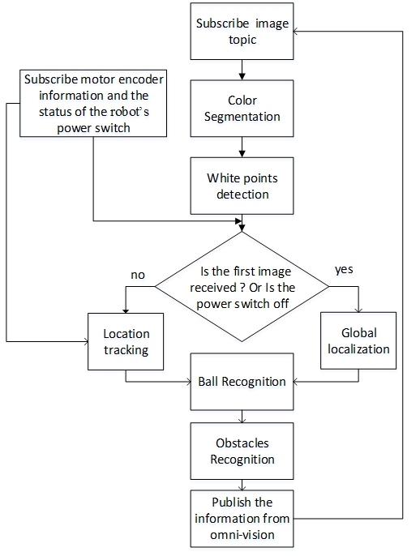
Flow Diagram of Omnivision Node

Slide 24
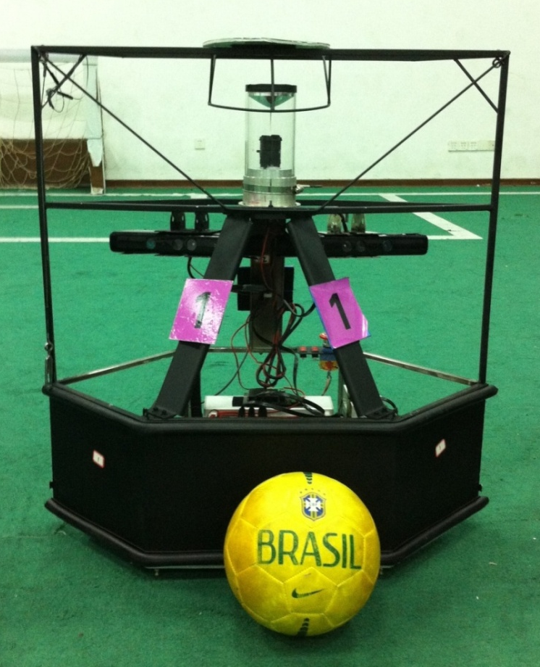
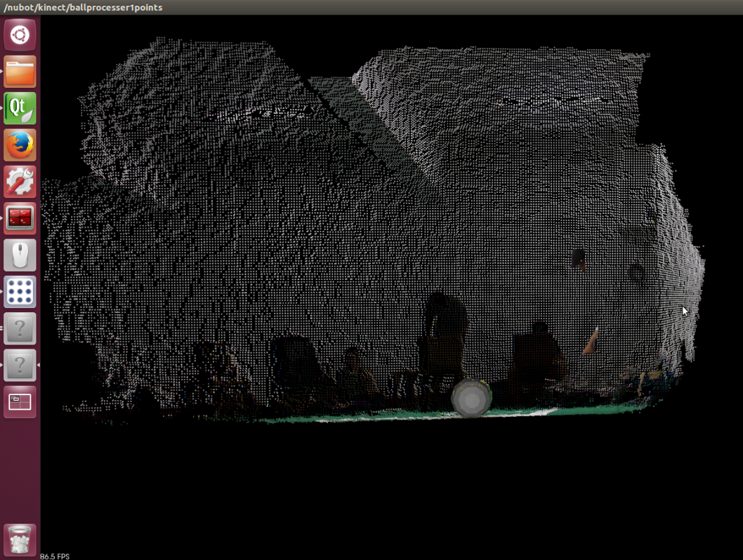
RGB-D Sensors for Goalie
Images acquiring and processing with OpenNI+PCL

Slide 25
Algorithm Flow Chart
Find out ball candidates witch color-segmentation
2
Sphere fitting with RANSAC
Accumulate a history of ball positions(3d)
3
Parabola Fitting with Least-square-method
4
Calculate the touchdown-point
5
1
Demo

Slide 26
Outline
New mechanical design
The vision system
The electrical system
ROS-based softwares

Slide 27
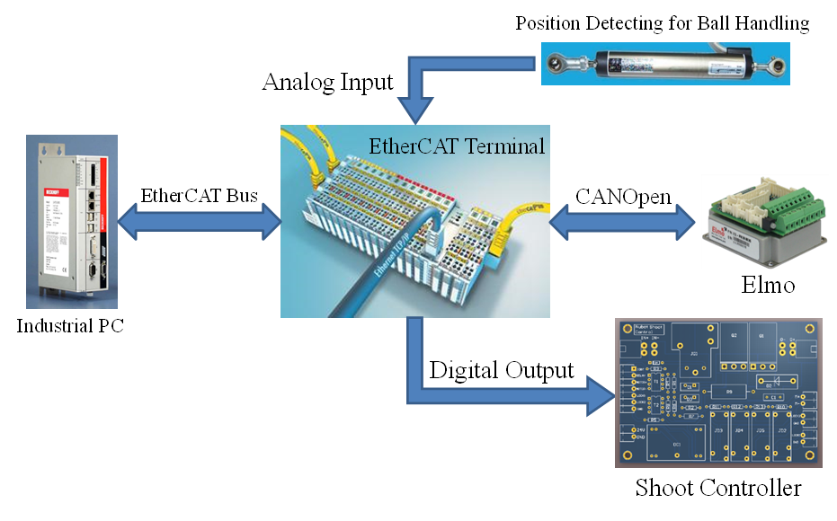
System overview

Slide 28
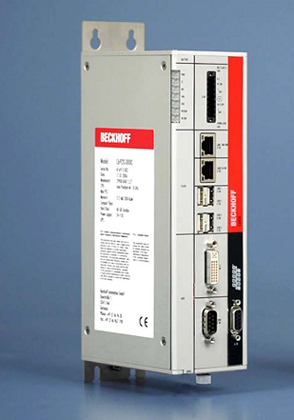
Onboard PC
Beckoff Industrial PC:
Size : 65 x 231 x 116 mm;
CPU : Intel® Core™ i7, 4 Cores;
RAM : 8G, DDR3;
HDD : 60G, SSD;
Power: DC 24V;
Features:
Compact;
Reliable;
High performance;
Very Expensive!

Slide 29
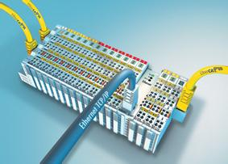
EtherCAT Terminals
EK1100
The EtherCAT Coupler terminal which is essential.
EL2008
Digital Output terminal for shooting control.
EL6751
Gateway terminal to bridge EtherCAT with CANOpen.
EL3064-0010
Analog Input terminal for ball position detecting.

Slide 30
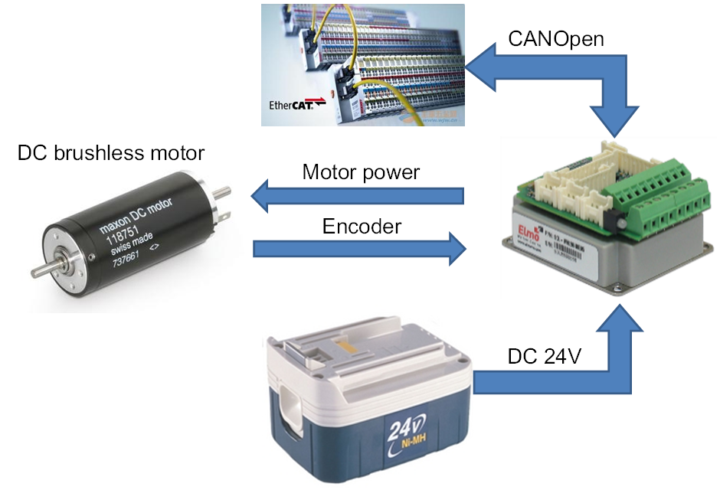
Elmo motor controller

Slide 31
EL6751 Configuration Using SOEM
SOEM - Simple Open-source EtherCAT Master.
The configuration of EL6751 using SOEM is tricky and few have succeed!
Solution:
Generate Startup codes and configuration codes with the help of TwinCAT, which is supported by Beckhoff;
Configure EL6751 with the codes generated above using simple functions of SOEM;
The configuration codes generation using TwinCAT (please find the details in the supplement slides)

Slide 32
Outline
New mechanical design
The vision system
The electrical system
ROS-based softwares

Slide 33
Why ROS?
Great flexibility and easy to use;
The modularity and re-usability of the code can be improved;
Lots of useful tools for debugging;
Maybe a good chance for promoting the mixed team for RoboCup. ROS community is trying to provide better support for multi-robot system;
Better data logging and sharing between teams?

Slide 34
System Structure of Nubot
Decision
Sensing
Driver
Nubot_control
World
model
rtdb
front_vision
uvc_camera
omni_vision
procilica_ camera
Nubot_ hwcontroller

Slide 35
Existing problems
Not optimized for real-time application, users have to DIY process management and scheduling;
Version problems. Some driver packages are obsoleted and not supported in newer ROS version;
Solutions to fix questions depend on ros.answer, but seldom have replies;
A kinds of small bugs;

Slide 36
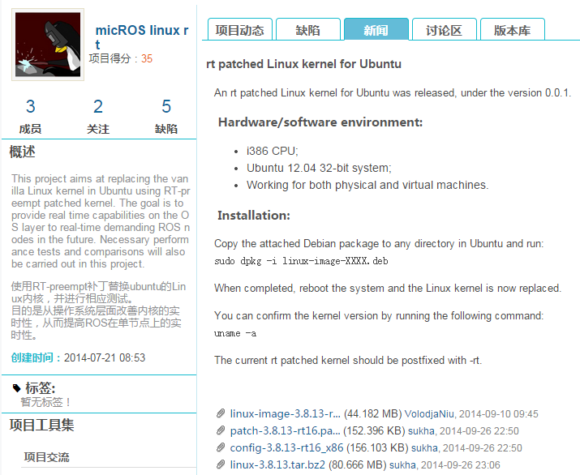
RT-patched Linux kernel for Ubuntu
http://micros.nudt.edu.cn/ros/news/217

Slide 37
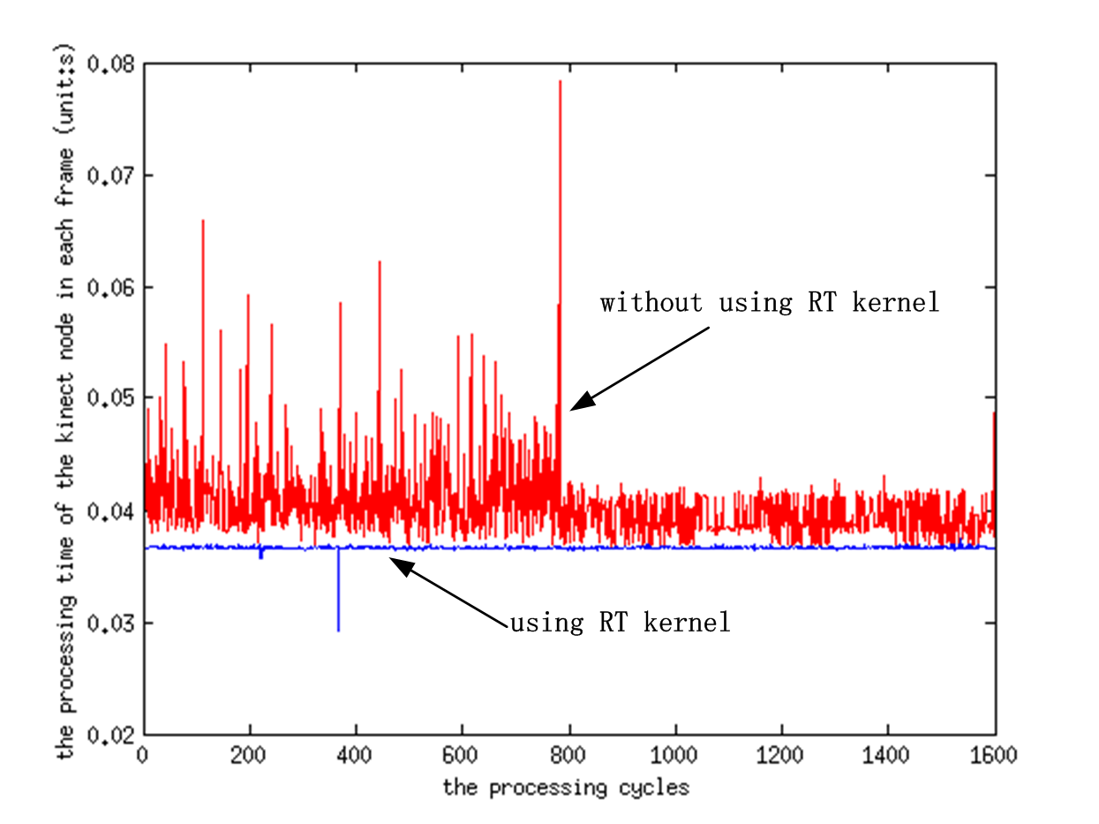
Experiment
Processing time in the kinect node with and without RT Kernel

Slide 38
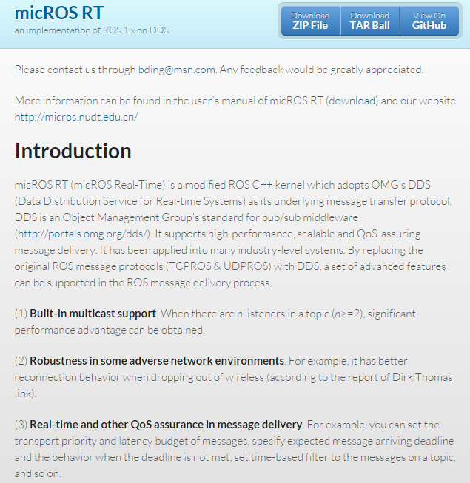
micROS RT
Notes:
We are also going to test a modified ROS C++ kernel which adopts DDS (Data Distribution Service for Real-time Systems), which is developed by micROS group of NUDT

Slide 39
Thanks for your attention!
https://github.com/nubot-nudt/

